Slide 1

PROJECT TITLE
Phase 1- Review 2
Group No :
GUIDE:
S.No | Name | Roll Number
1 | Akhil Swarop S | CB.EN.U4CSE21304
2 | Ganeshkaran M | CB.EN.U4CSE21312
3 | Hanish K R | CB.EN.U4CSE21317
4 | Hidesh Balaji C U | CB.EN.U4CSE21320

Slide 2
Guide’s Approval Mail

Slide 3
Introduction

Slide 4
Motivation

Slide 5
Literature Survey

Slide 6
Research Gap

Slide 7
Problem Statement

Slide 8
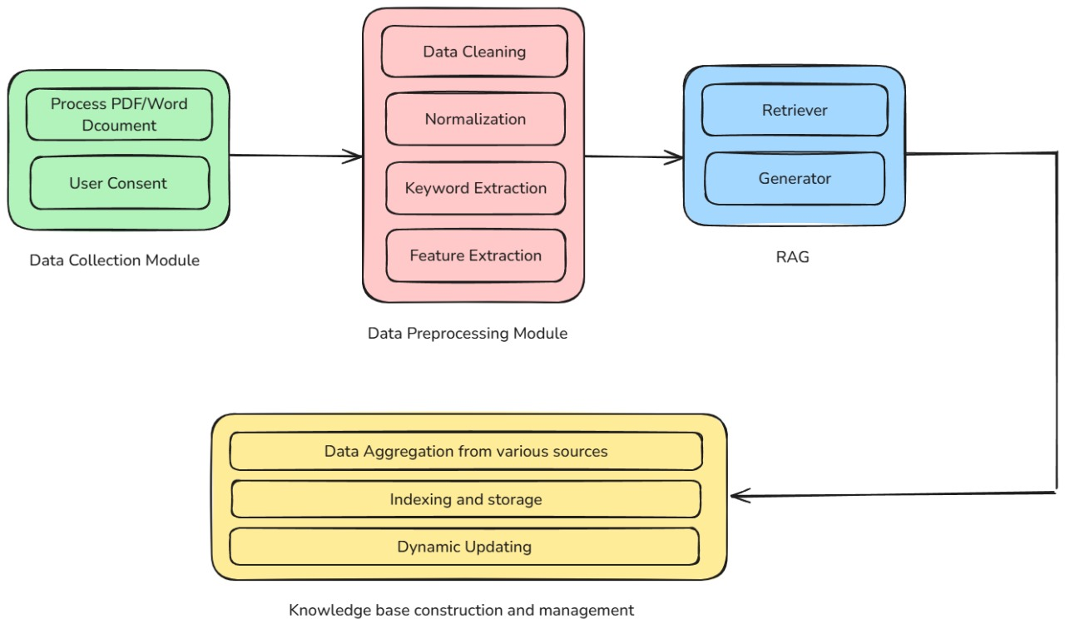
System Design: Architecture and Algorithms/Techniques

Slide 9
Module Description

Slide 10
Role of each Student: 30% of Prototype Implementation

Slide 11
Demo of implementation
Link needs to be provided for the demo.

Slide 12
Work Plan and Publication Plan for phase 2

Slide 13
References

